Slide 1
Evenmore
Events, Culture, Community.
Hypyxel

Slide 2







PROJECT AT A GLANCE

Slide 3
01
OUR INTRODUCTION

Slide 4
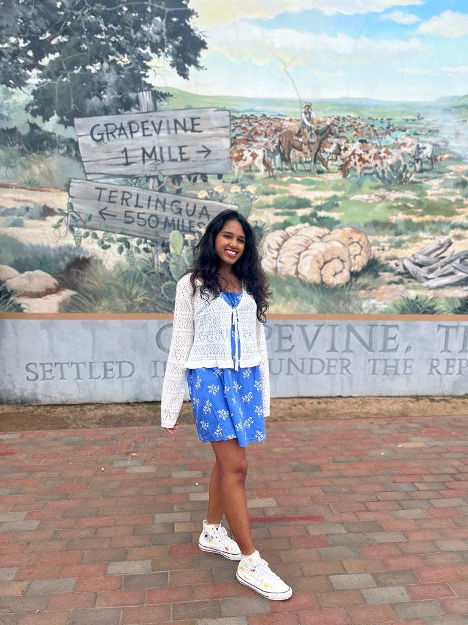
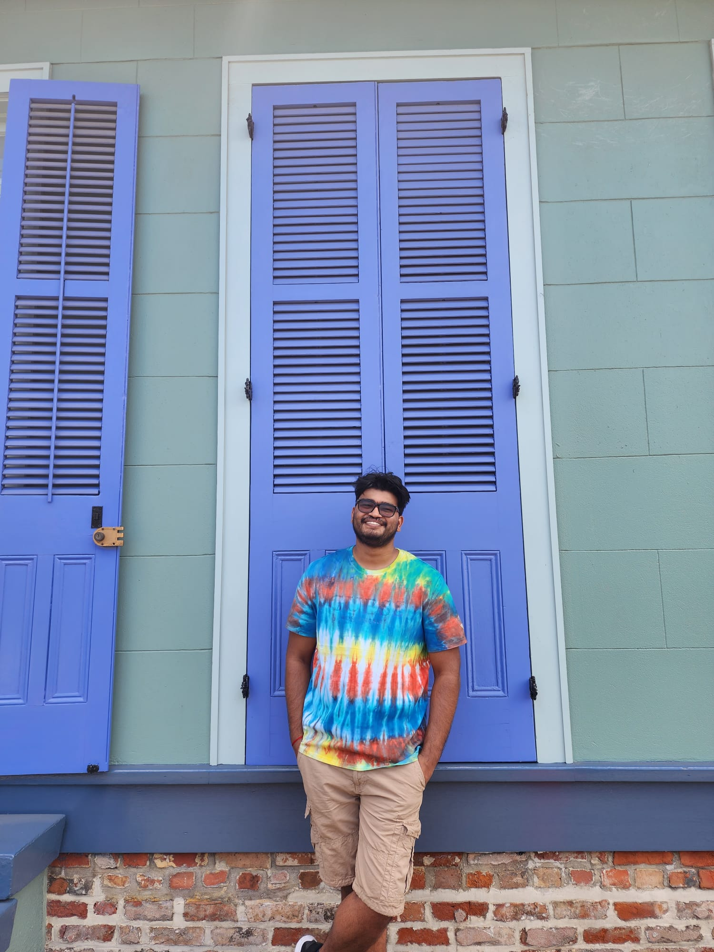
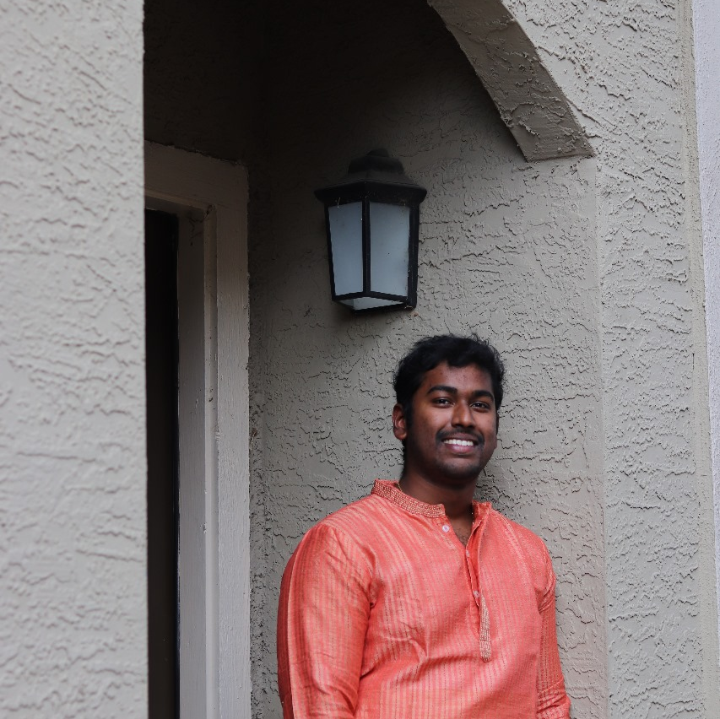
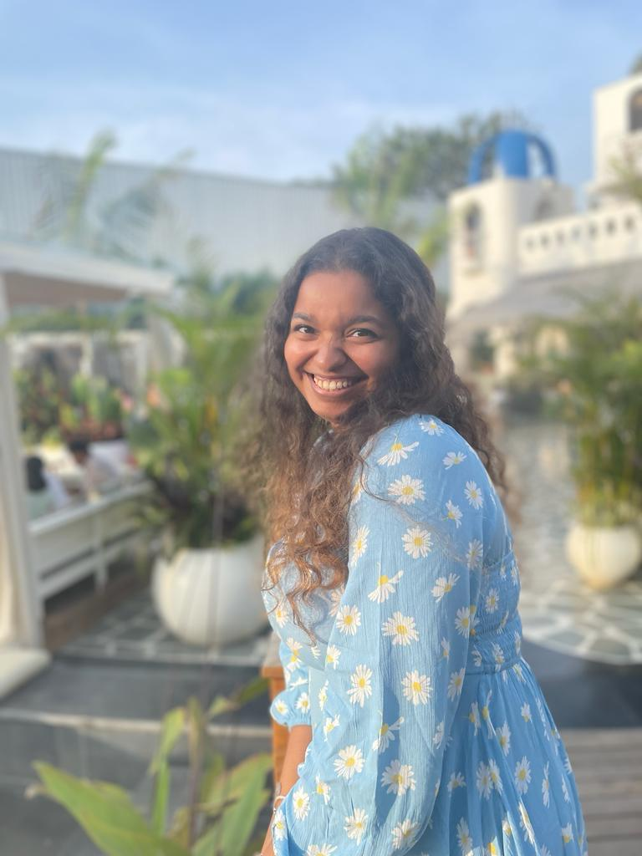
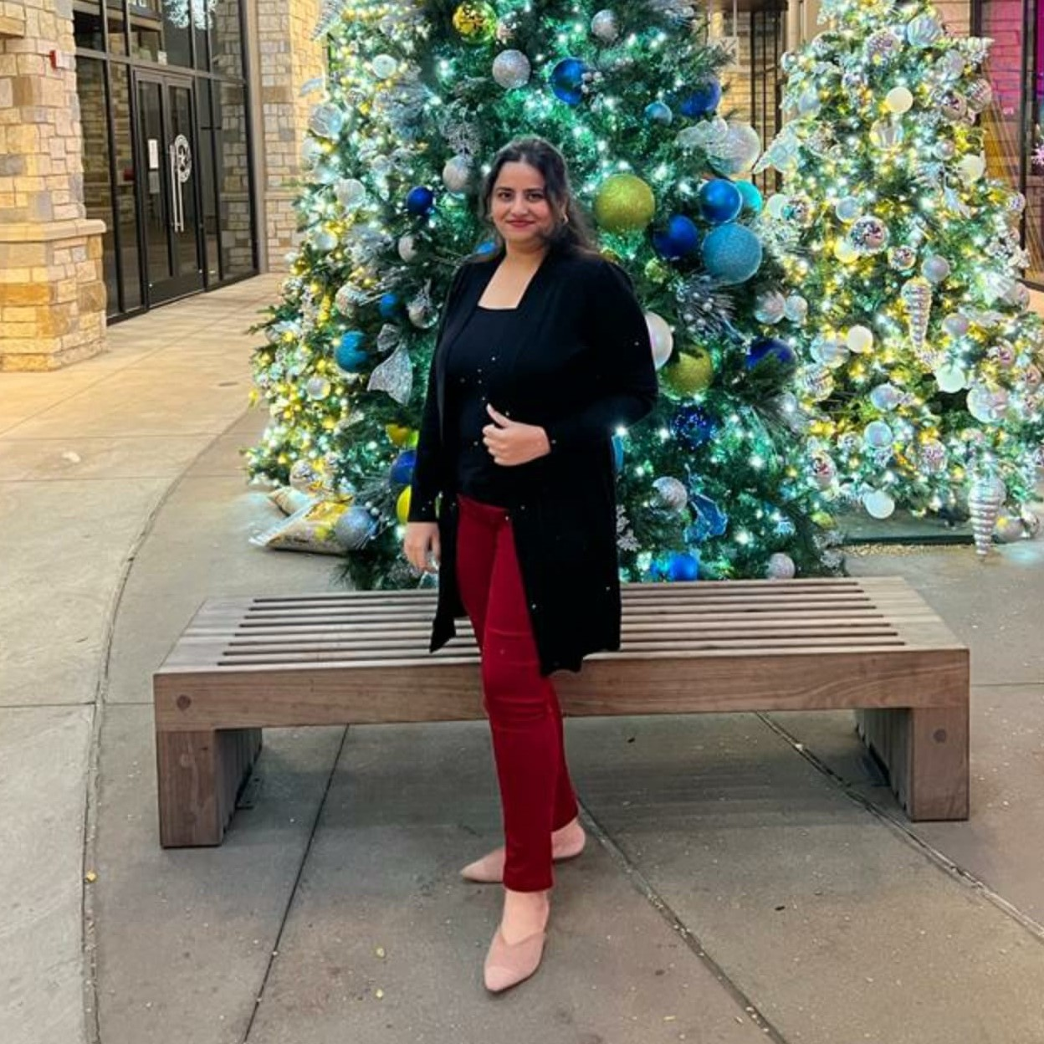
Ritica
Rishab
Ashwin
Raksha
Rutuja
Ritica
Rishab

Slide 5
Rutuja
Ritica
Rishab
Ashwin
Raksha
Rutuja
Ritica

Slide 6
Raksha
Rutuja
Ritica
Rishab
Ashwin
Raksha
Rutuja

Slide 7
Ashwin
Raksha
Rutuja
Ritica
Rishab
Ashwin
Raksha

Slide 8
Ashwin
Raksha
Rutuja
Ritica
Rishab

Slide 9


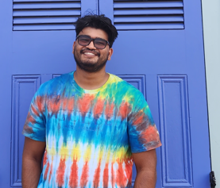
I'm Rishab, a 24-year-old with a passion for aeromodelling. I'm currently pursuing a Master's in Business Analytics. But when I'm not immersed in numbers, you'll find me geeking out at events like Comic Cons.
I've had the privilege of interning at DRDO (Defense Research and Development Organization), where I got a taste of cutting-edge tech.

Slide 10
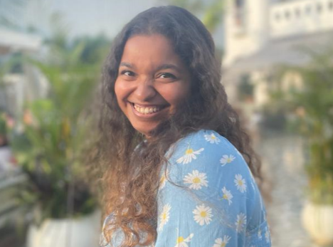
I'm Raksha Rajasimha, a 26-year-old data wizard with a Master of Science in Business Analytics. I spent a couple of years at Tesco, where I got a taste of the retail hustle.
When I'm not working, you'll likely find me exploring my passion for all things German – whether it's savoring bratwurst, attempting to speak the language, or diving into the rich world of German events.

Slide 11
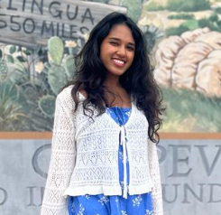
I'm Ritica, a 23-year-old diving into the world of Salesforce. I'm currently pursuing a Master's in Business Analytics, and when I'm not studying, I'm all about exploring the delicious world of Korean cuisine and getting lost in the drama of K-dramas.
Right now, I'm gaining some real-world experience through my internship at MyUtilities.

Slide 12
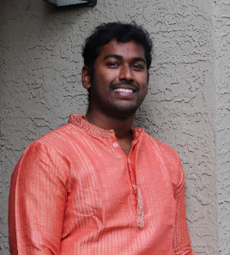
I'm Ashwin, a 21-year-old data enthusiast currently pursuing a Master's in ITM. Before that, I spent a year interning at SpotFlock, learning the ropes and gaining some hands-on experience.
My interests lie in photography events. Capturing those perfect moments and emotions through my lens is my happy place.

Slide 13
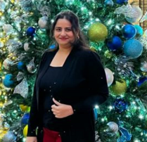
I'm Rutuja, a 25-year-old on a mission to decode the secrets of products as a Product Analyst. I'm currently pursuing my Master's in ITM, and I previously worked for three years at TCS, gaining valuable experience in the corporate world.
My interest lies in the world of Indian dance events, exploring the rich tapestry of our traditional moves.

Slide 14
02
OUR PURPOSE

Slide 15

PROBLEM STATEMENT
MISSION STATEMENT
Many students miss out on exciting events and opportunities happening around them because of the scattered and inconsistent way event information is shared on social media and other platforms.
Also, small businesses struggle to effectively market their products and services, hindering their growth and sustainability.
A centralized platform is required that not only links students to various events but also provides a cost-effective and efficient marketing channel for small business owners to reach their target audience and foster economic growth.
"Empowering Small Businesses, Building Awareness, and Strengthening Communities through Exceptional Events."

Slide 16
VISION STATEMENT
PROBLEM STATEMENT
MISSION STATEMENT
In our vision, we aspire to create a future where every student can seamlessly explore, engage with, and partake in various cultural events while empowering small business owners to flourish through active involvement in these enriching experiences.
Many students miss out on exciting events and opportunities happening around them because of the scattered and inconsistent way event information is shared on social media and other platforms.
Also, small businesses struggle to effectively market their products and services, hindering their growth and sustainability.
A centralized platform is required that not only links students to various events but also provides a cost-effective and efficient marketing channel for small business owners to reach their target audience and foster economic growth.
"Empowering Small Businesses, Building Awareness, and Strengthening Communities through Exceptional Events."

Slide 17
VISION STATEMENT
MISSION STATEMENT
In our vision, we aspire to create a future where every student can seamlessly explore, engage with, and partake in various cultural events while empowering small business owners to flourish through active involvement in these enriching experiences.
"Empowering Small Businesses, Building Awareness, and Strengthening Communities through Exceptional Events."

Slide 18
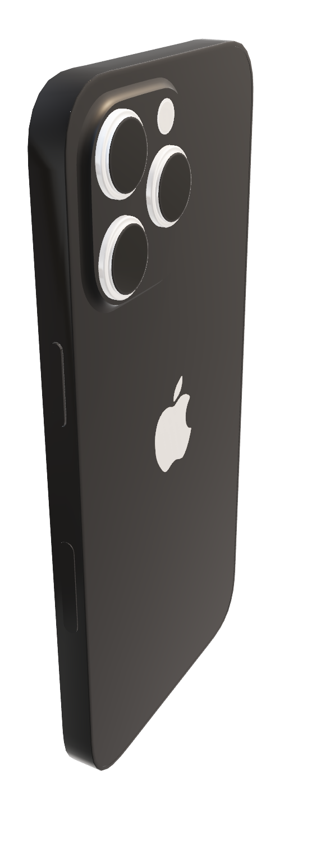
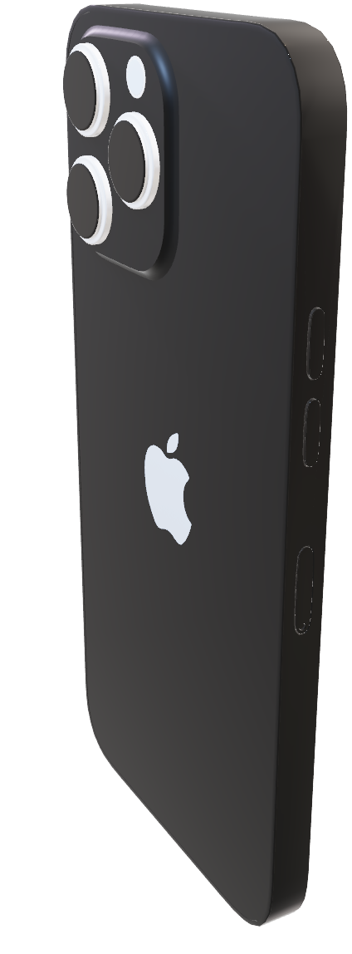
Budget Friendly
Raise Awareness of Brand
03
Build Customer Base
Discover Events
OUR SOLUTION
Get Discounts
Empower the Community
Centralized Platform
At Evenmore, we are dedicated to empowering students to easily discover events and exclusive promotions while helping small businesses thrive and connect with their community through our all-in-one platform.

Slide 19


POSITIONING STATEMENT
Budget Friendly
Raise Awareness of Brand
Discover Events
Build Customer Base
Get Discounts
Empower the Community
Centralized Platform
At Evenmore, we are dedicated to empowering students to easily discover events and exclusive promotions while helping small businesses thrive and connect with their community through our all-in-one platform.

Slide 20
Budget Friendly
Raise Awareness of Brand
POSITIONING STATEMENT
“At Hypyxel, we are dedicated to empowering students to easily discover events and exclusive promotions while helping small businesses thrive and connect with their community through our all-in-one platform.”
Build Customer Base
Discover Events
Get Discounts
Empower the Community
Centralized Platform

Slide 21
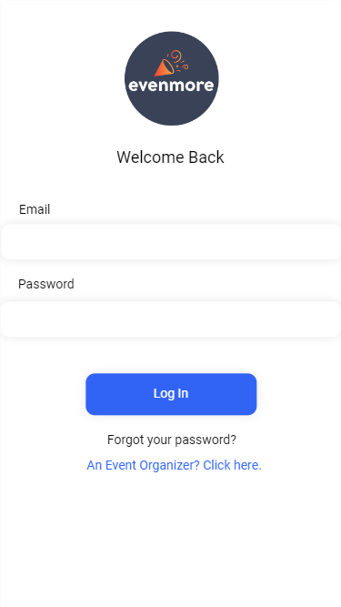
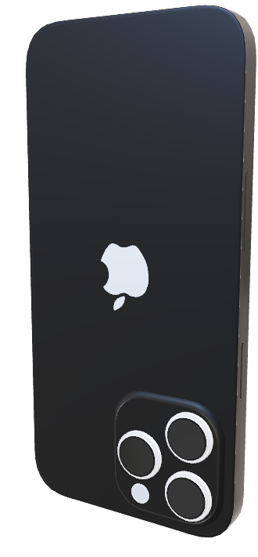


Slide 22
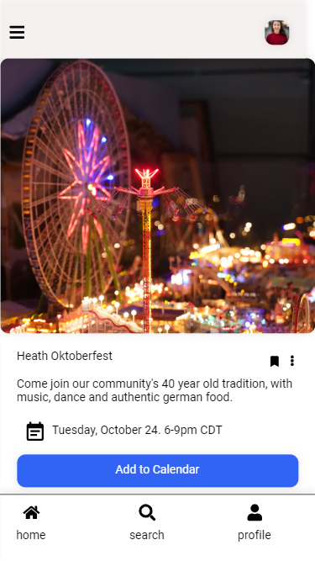
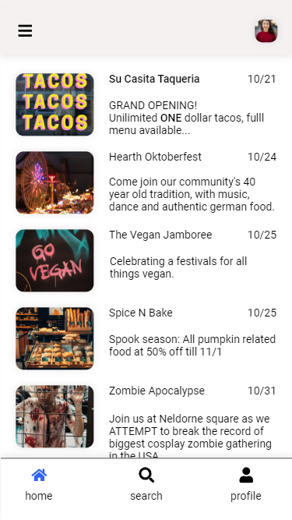
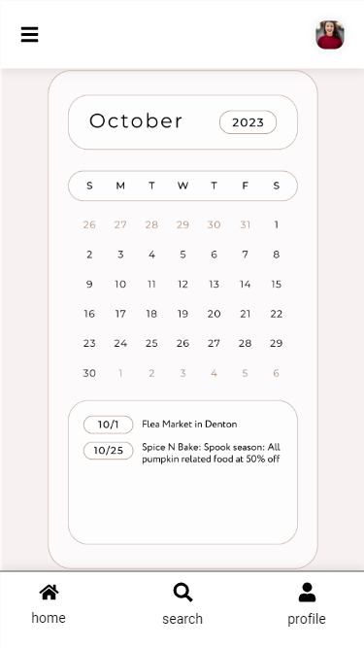
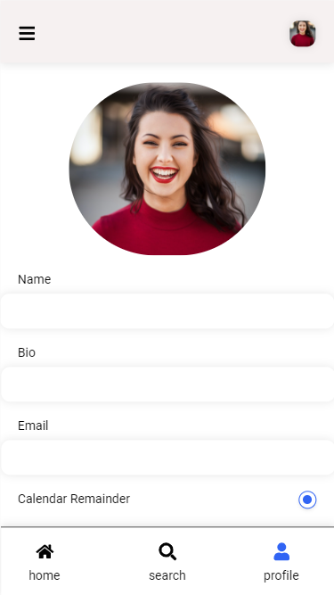
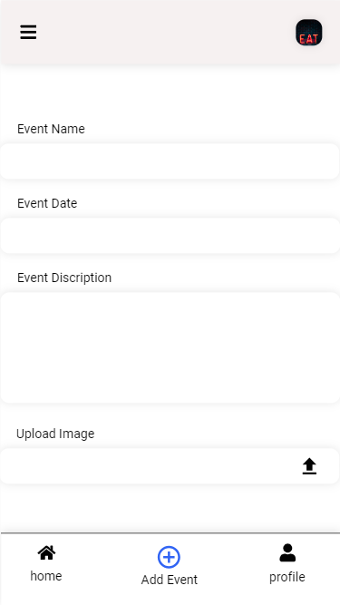

Slide 25

04
OUR CUSTOMERS
EMILY SHARP

Slide 26
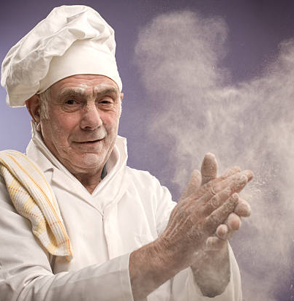
Target Customer
Emily, the College Sophomore:
Age: 20
Interests: Art exhibitions, poetry readings, cultural fests.
Behaviors: Actively seeks out events to attend with friends, and uses social media frequently.
Goals: Expand her cultural horizons and meet like-minded individuals.
EMILY SHARP

Slide 27
Target Customer
Mr.Pitt, the Owner of ‘Knead for speed’:
Age: 52
Interests: Hosting themed evenings and exotic coffee-tasting sessions.
Behaviors: Struggles with marketing his events and relies on word of mouth.
Goals: Increase footfall in his cafe and become a popular student hangout spot.
BREAD PITT

Slide 28
05
OUR COMPETITORS

Slide 29
S
W
O
T
Strength
Weaknesses
Opportunities
Threats
Niche focus
local partnerships
New entrant
Reliance on local content
Expansion to other cities
Integration with other platforms
Established competitors
Changing student behaviors

Slide 30
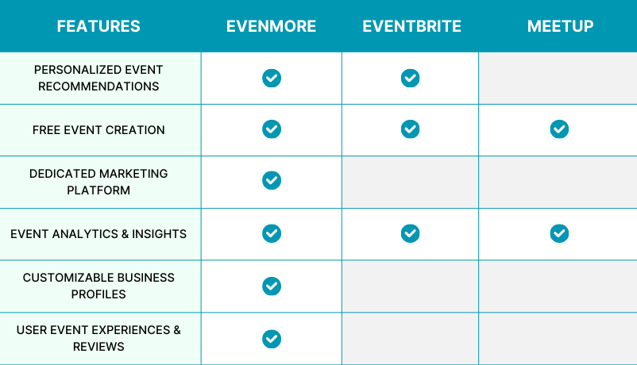

Slide 31
06
OUR VISION

Slide 32


PRODUCT TIMELINE
Launch in DFW Metroplex
Website Launch
1
OCTOBER
2023
Launch on iOS App
.
NOVEMBER
2
2023
Collaborate with Organizations
3
DECEMBER
2023
JANUARY
4
Event Management Portal for Hosts
Launch on Android App
2024
Social Media Integration
5
FEBRUARY
2024
MARCH
2024
6
Calendar integration
Push notification

Slide 33
PRODUCT TIMELINE
Geolocation Services
7
APRIL
2024
MAY
8
Personalized Event Recommendations
2024
User Reviews
9
JUNE
2024
JULY
10
Introducing premium tier
2024
Food Mystery box
11
AUGUST
2024
BEYOND SEPTEMBER
12
Availability in other cities

Slide 34
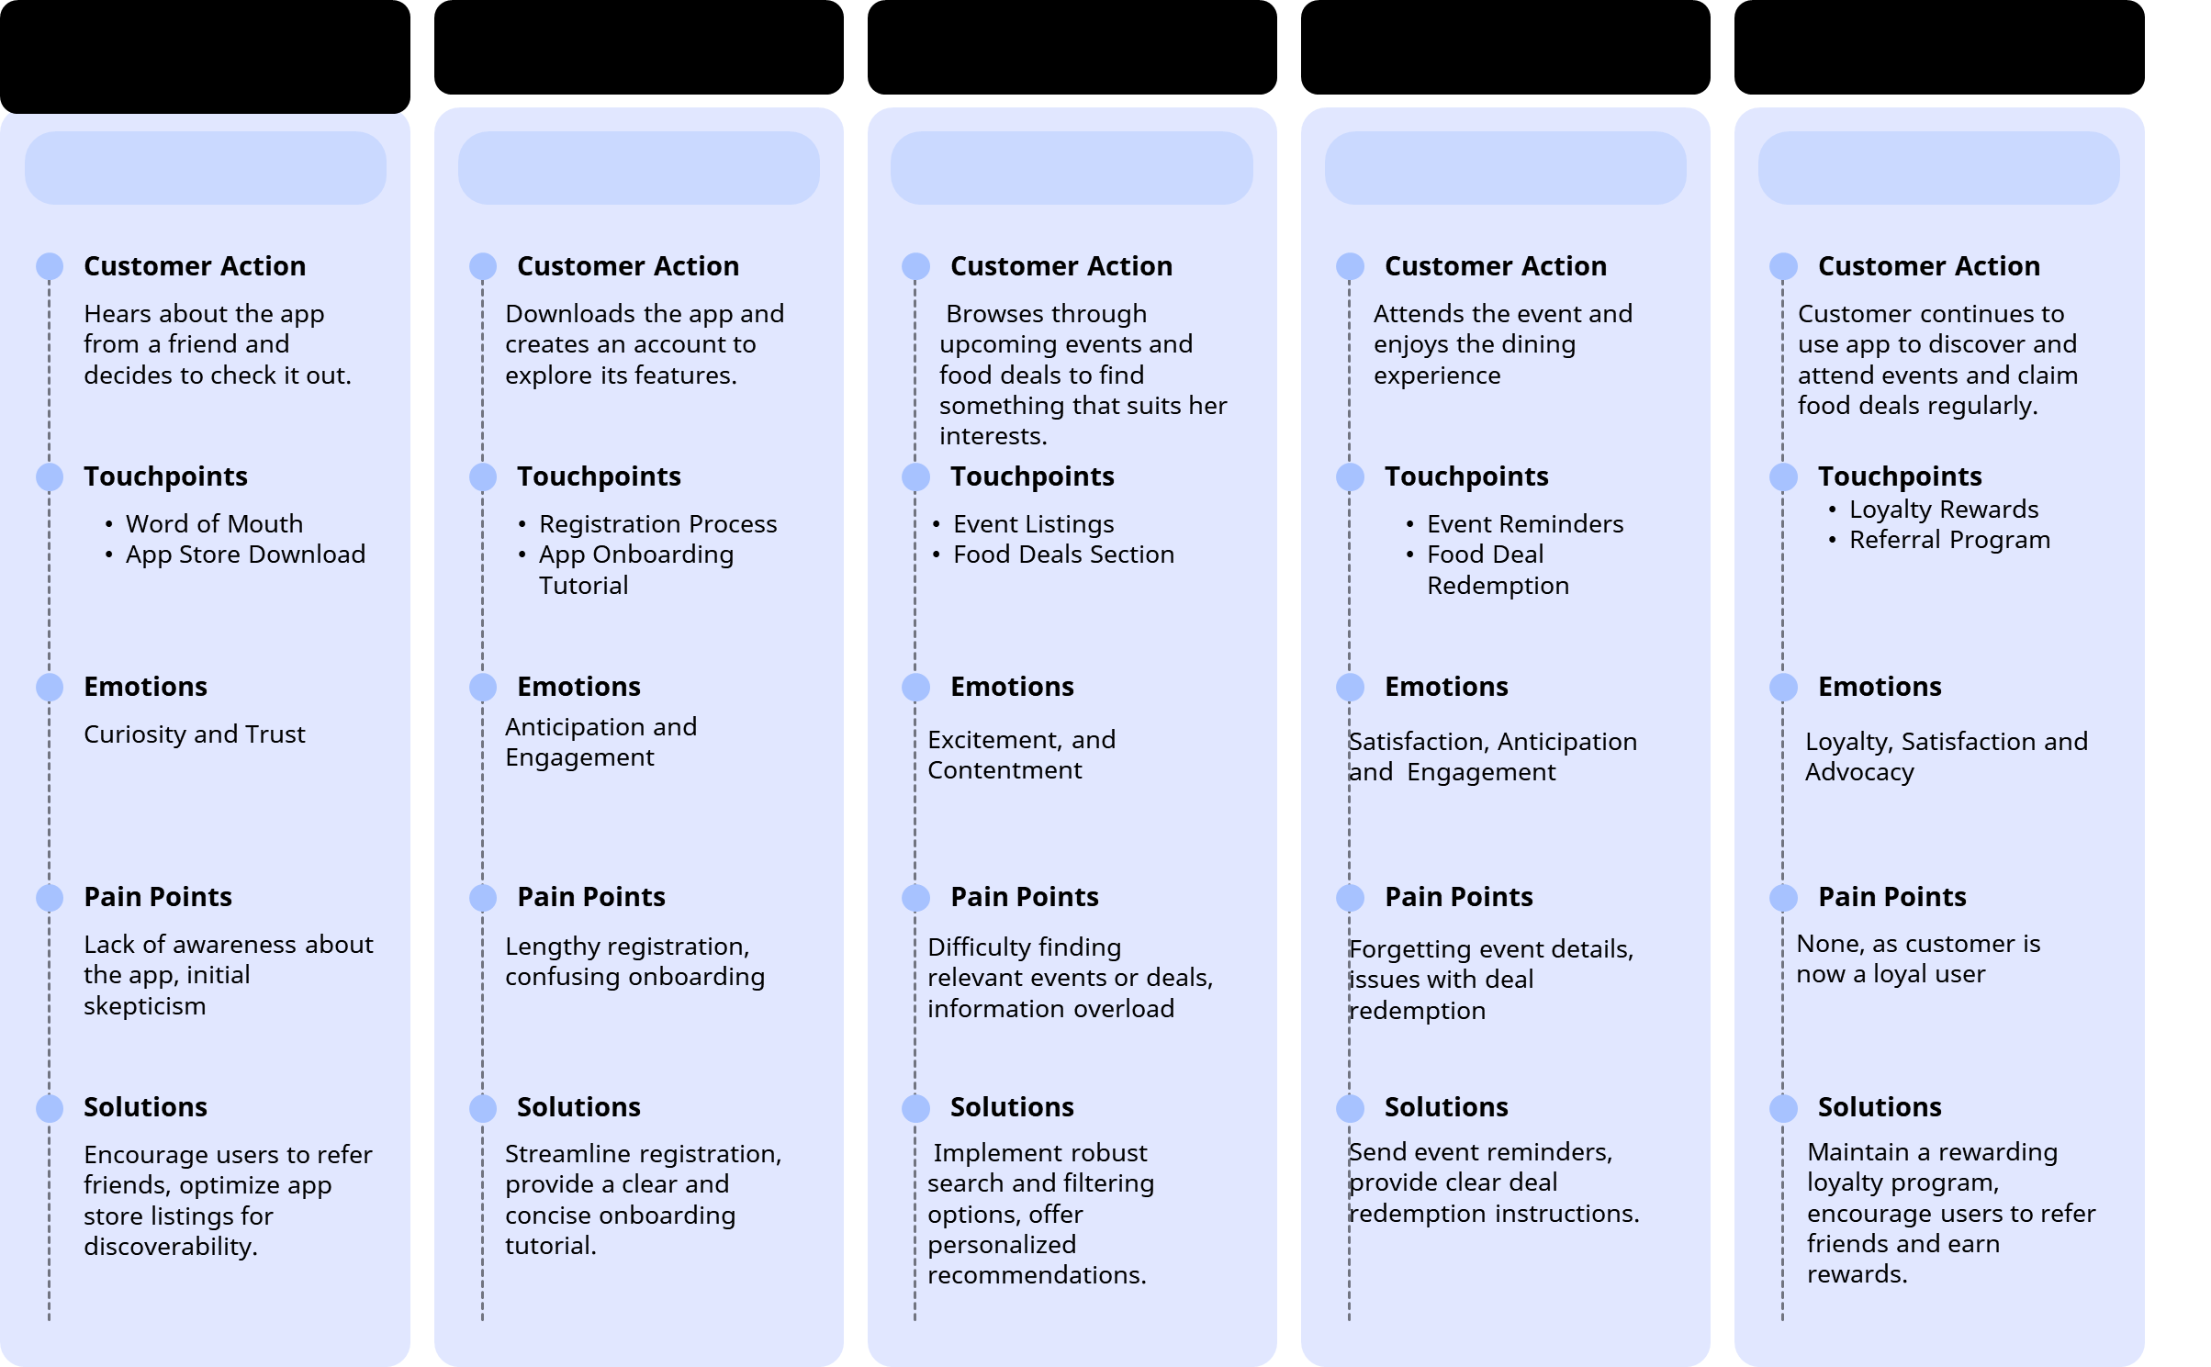
Discovery and Awareness
Consideration
Evaluate and Decision
Service
Loyalty
CUSTOMER JOURNEY
Phase 1
Phase 2
Phase 3
Phase 4
Phase 5

Slide 35


